Slide 1



Slide 3


Waarom?
Onze aanpak.
Hoe was onze werkverdeling?

Slide 4


Media

Slide 5
Software

Slide 6
Software

Slide 7
Technology

Slide 8
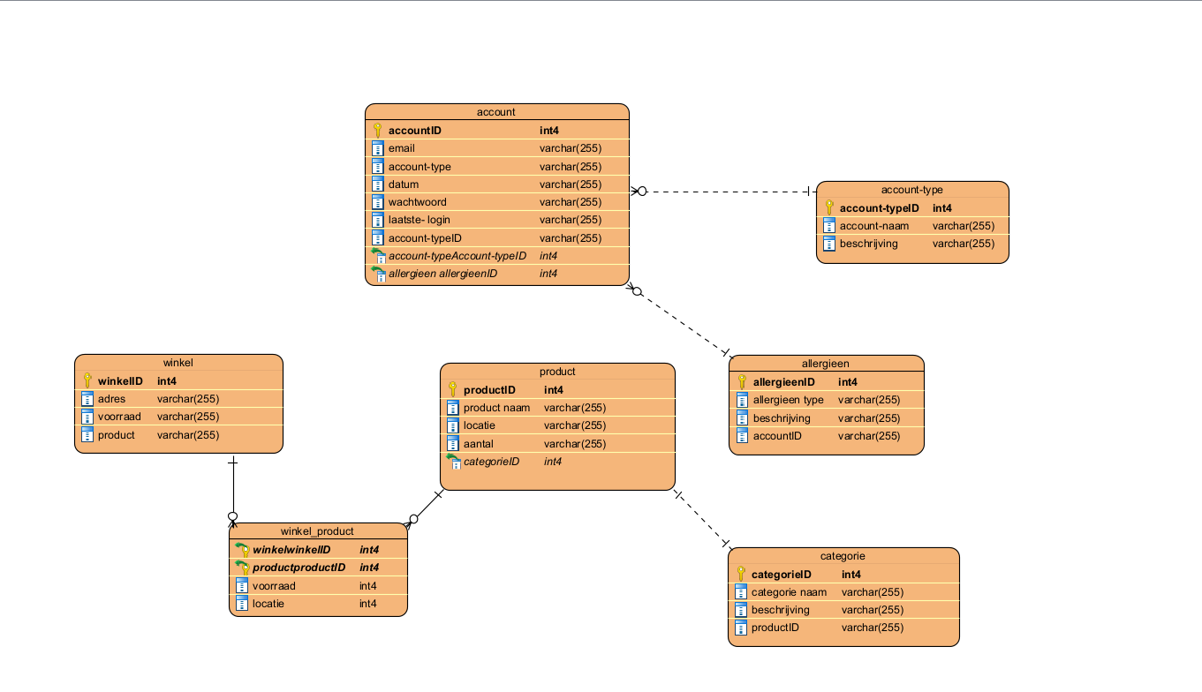
Business

Slide 9
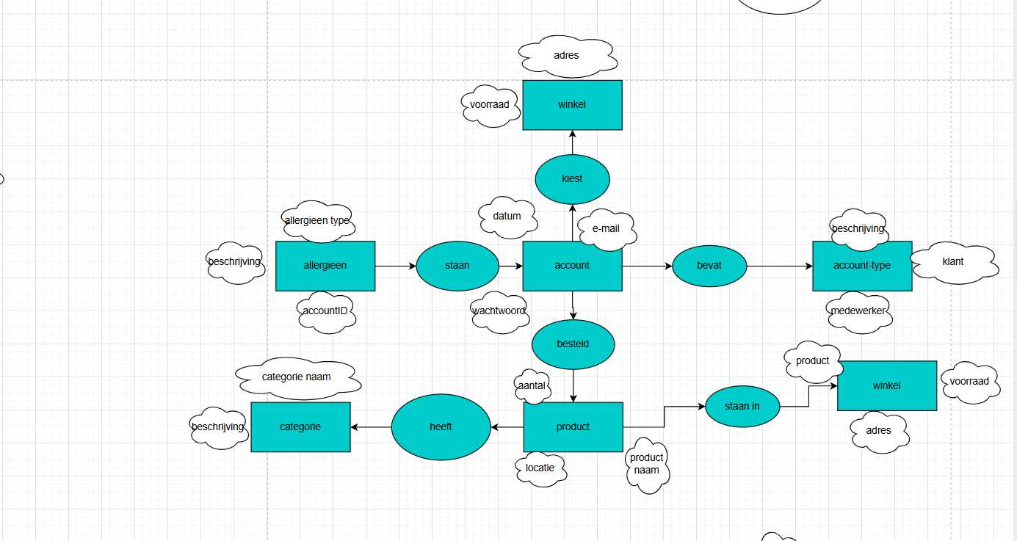
Business

Slide 10
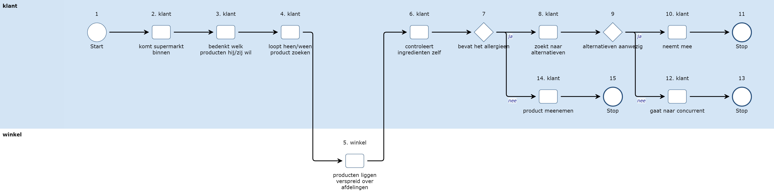
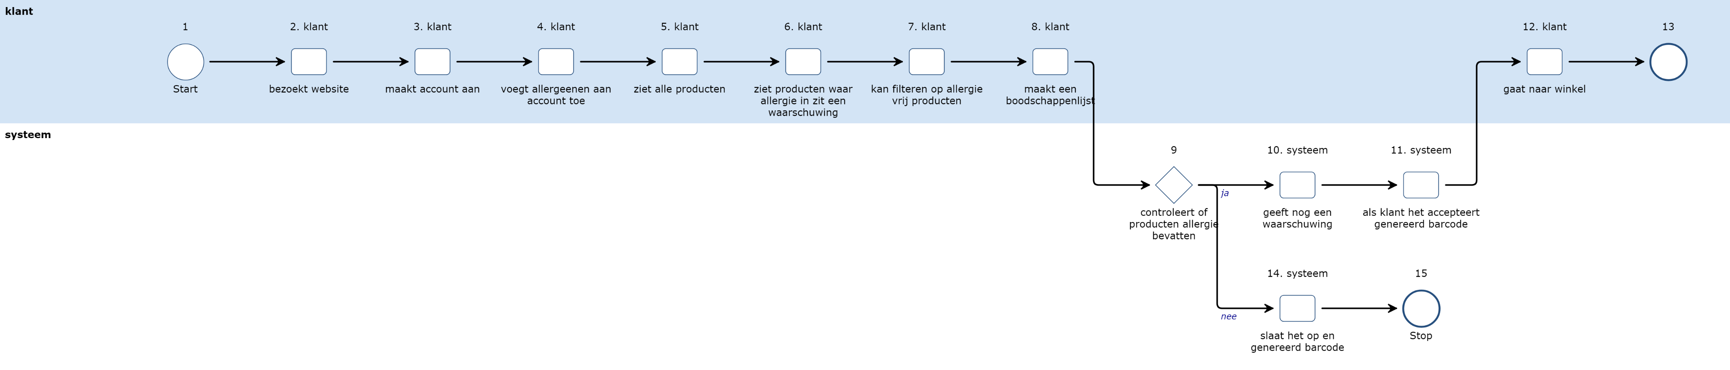
Business

Slide 11
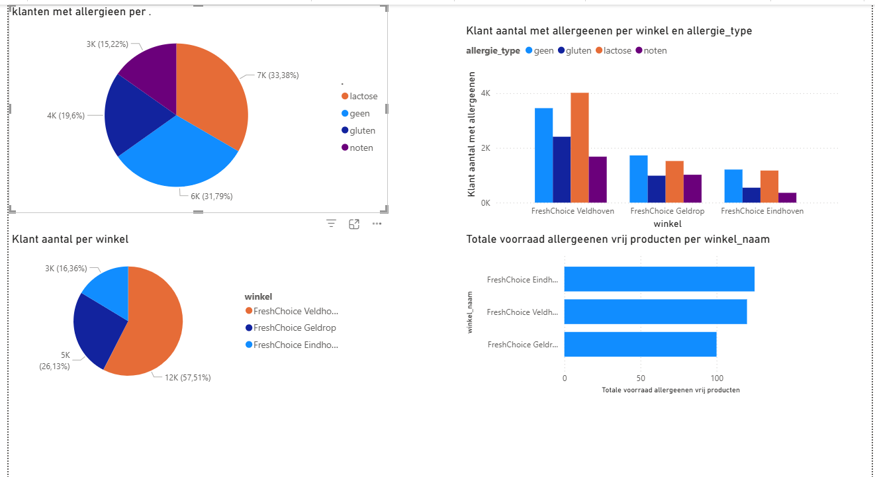
Business

Slide 12


